Slide 1
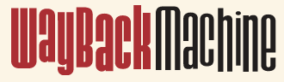
Rewriting History: Changing the Archived Web from the Present
By: Ada Lerner, Tadayoshi Kohno, and Franziska Roesner
&
Thinking like a Hacker: Security Considerations for High-Fidelity Web Archives
By: Jack Cushman, Ilya Kreymer
Presented by: Evan Savaria
CS 895: Web Archiving Forensics
November 05, 2020

Slide 2
Outline
Introduction
Archive Vulnerabilities
Lifecycle of Archived Snapshots
Analyzing Vulnerabilities and Attacks
Deploying Defenses
Contributions
Conclusions/Final Thoughts
Evan Savaria, 2020-11-05, Rewriting History, Thinking Like a Hacker
2

Slide 3
Introduction –The Wayback Machine
“Rewriting History: Changing the Archived Web from the Present” explains the incentives to intentionally manipulate these web archives and prevalence
“Thinking like a Hacker: Security Considerations for High-Fidelity Web Archives” explains why security is a concern from both capture and replay perspectives:
Capture | Replay
Stealing user secrets | Banner spoofing
Archiving local server files | Live web leakage
Hacking headless browsers | Cross sight scripting to steal logins
Evan Savaria, 2020-11-05, Rewriting History, Thinking Like a Hacker
3

Slide 4
How Web Archives are Used
The Wayback Machine is a high fidelity archive database of over 286 million web pages captured between 1996-2017
Web Archives are used in the legal context
It is important to ensure data integrity in the legal system
Legal proceedings may motivate parties to launch attacks on data to manipulate the truth or hide evidence
Lawyers use web archives for civil lawsuits often
Advised to employ experts to validate data found in the web archives
Web Archives used in technical fields
Computer scientists use the Wayback Machine in research
There are studies that have developed a method for determining what websites are likely to be attacked
Other studies describe incompleteness in the web archives
Evan Savaria, 2020-11-05, Rewriting History, Thinking Like a Hacker
4

Slide 5
Archive General Vulnerabilities
Archives can become corrupted through the accidental mixing of live and archived content
Ability to inject arbitrary JavaScript code into archived snapshots allows the modification of text, images, styling, and behaviors of past webpages
These attacks are common and have been happening for over 20 years
In 2017, 75% of the top 500 popular websites contained a type of vulnerability that could potentially allow an attacker to obtain complete control of the snapshot
Legal sites are also impacted
In the same year these measurements were performed, it was found 37 domains and 991 legal documents were vulnerable
Evan Savaria, 2020-11-05, Rewriting History, Thinking Like a Hacker
5

Slide 6
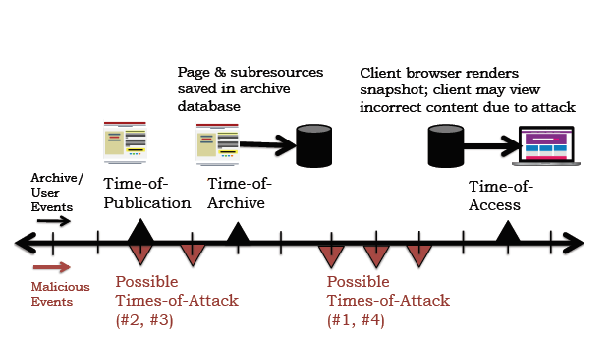
Lifecycle of Archived Snapshots
Web archive replay can pose new security risks
High-Fidelity web archives run untrusted web software
Source: Rewriting History: Changing the Archived Web from the Present
The threat model in this article defines an attack when clients are maliciously attacked and given inaccurate content that is not reflective of the past website
Evan Savaria, 2020-11-05, Rewriting History, Thinking Like a Hacker
6

Slide 7
Plan of Attack on the Archives
An attack is successful when the client’s browser displays inaccurate content that is not reflective of the past website
The attacker may decide to modify their own content to avoid being caught after their initial attack
It is possible in some instances that the attacker could purchase a specific domain to launch attacks using a business that was once owned by someone else
Evan Savaria, 2020-11-05, Rewriting History, Thinking Like a Hacker
7
Notes:
The main goal of the many attacks described in this article is to focus on changing what a client’s view is from a snapshot

Slide 8
Analyzing Three Types of Replay Vulnerabilities
Archive-Escapes use live-web resources as part of a snapshot view
This vulnerability allows the attacker to place malicious code on the live copy of the website
Same-Origin Escapes occur when first and third party data making up a snapshot is loaded by the client from the archive and allows third-party resources in <iframes> to modify the main page
This vulnerability permits an attacker to embed malicious code to modify a page
Never-Archived Resources send clients a 404 error when asked for data that was never archived
This vulnerability can be used by attackers to insert malicious payloads into missing resources
Evan Savaria, 2020-11-05, Rewriting History, Thinking Like a Hacker
8
Notes:
While these vulnerabilities describe the Wayback Machine, they could also be used to manipulate similar web archive systems

Slide 9
Rewriting History: Changing the Archived Web from the Present
Attack #1: Archive-Escape Abuse
Conditions
Archive-Escape attack is possible when the attacker is the owner of the archive-escape requested by the client
Concept
The attacker publishes malicious content at the escaping URL
Static resources, scripts and style sheets can be affected
Sequence of Events:
Victim page is published
Victim page is archived
Client requests the snapshot and activates the archive-escape
The attacker responds to the archive escape by sending malicious code
Evan Savaria, 2020-11-05, Rewriting History, Thinking Like a Hacker
9

Slide 10
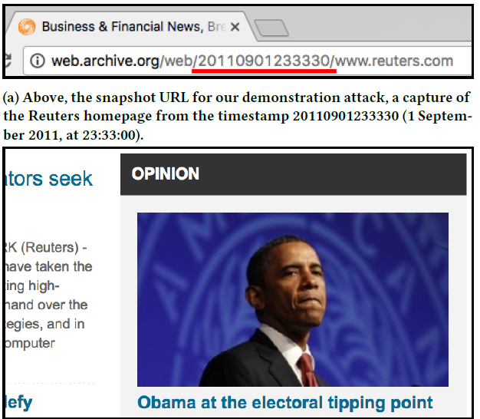
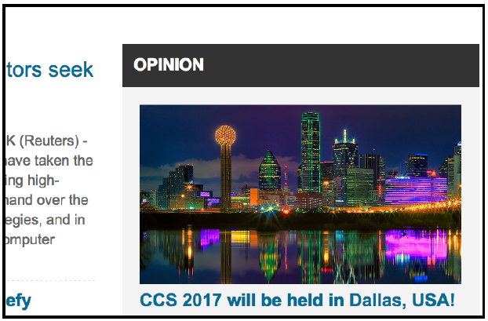
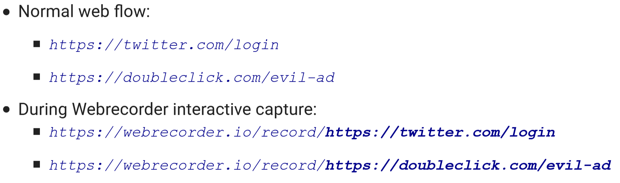
Rewriting History: Changing the Archived Web from the Present
Attack #1:Proof of Concept
Original URL: http://web.archive.org/web/20110901233330/reuters.com
Archive-escaped to: http://cdn.projecthaile.com/js/trb-1.js
Advantages:
This active attack delivers a malicious payload directly to the client
Allows customization of the attack per client
Disadvantages:
The attack is not permanent
Defense methods to block this type of attack are easy to deploy
Mitigation:
Record using a Browser Proxy
Use separate recording sessions for sensitive information
Source: Thinking like a Hacker: Security Considerations for High-Fidelity Web Archives
Evan Savaria, 2020-11-05, Rewriting History, Thinking Like a Hacker
10
Notes:
Projecthaile.com was purchased and a modified version of /js/trb-1.js was published to modify elements of the snapshot

Slide 11
Rewriting History: Changing the Archived Web from the Present
Attack #2: Same-Origin Escape Abuse
Conditions
Same-Origin Escape abuse is possible when all third-parties are included in <iframes> at time-of-archive requiring foresight of the attack
Concept
The client receives single origin frames from the archived snapshot instead of multiple origins as on the live web, thus bypassing the Same-Origin-Policy
There is an assumption by the first-party publisher that the Same-Origin-Policy will protect against malicious attacks
Sequence of Events:
Victim site includes a third-party <iframe> controlled by the Same-Origin Escape attacker
Third-party attacker published malicious code to the <iframe>
The malicious code is executed on the live web; however, it is blocked by the Same-Origin Policy
The first-party page is archived with the attackers <iframe>
The client requests a snapshot from web.archive.org ; therefore bypassing the Same-Origin Policy and executing the malicious code on the clients browser
Evan Savaria, 2020-11-05, Rewriting History, Thinking Like a Hacker
11

Slide 12
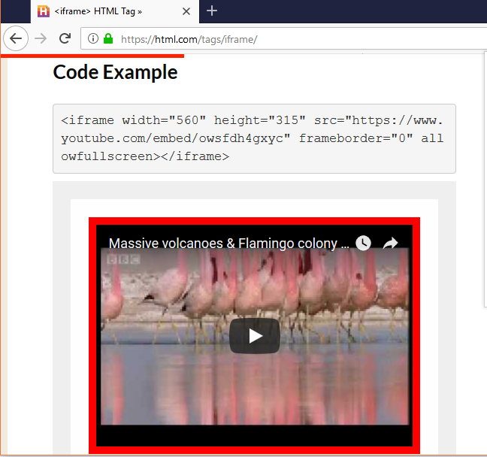
Rewriting History: Changing the Archived Web from the Present
Attack #2: Proof of Concept
https://webrecorder.io/record/https://websecurity.com/evil-ad
https://webrecorder.io/record/https://doubleclick.com/Volcanoes_Flamingos
Advantages:
Minimal prerequisites to perform the attack
Third-party frames are common and can be purchased for advertising
Some third-parties own massive shares of webpages making the attack scalable
Disadvantages:
The attacker must use foresight
The attack code must be stored in the archive
Evan Savaria, 2020-11-05, Rewriting History, Thinking Like a Hacker
12
Notes:
A victim page for the first-party domain was created on the live web and archived
This page included an <iframe> for a third-party domain that contained malicious code
The malicious code is then executed by the client on the live web in an attempt to modify the first-party page
The attack fails on the live web due to the Same-Origin Policy
The attack succeeds when the archived snapshot of the first-party and third-party content is viewed by a client on the domain

Slide 13
Rewriting History: Changing the Archived Web from the Present
Attack #3: Same-Origin Escape + Archive-Escape
Conditions
Same-Origin Escape + Archive-Escape is possible when a third-party <iframe> executes an archive-escape at a later time
Concept
The attacker uses a same-origin escape to start an archive-escape allowing the attacker to have full control of the victims snapshot page
The attacker can execute archive-escape abuse at anytime
Sequence of Events:
The attacker becomes a third-party who embeds an <iframe> into a first-party page
The attacker chooses a destination and malicious payload for the later archive-escape
The webpage and <iframe> are then archived
At any given time the attacker publishes a malicious code to the archive-escape URL
The client requests a snapshot from web.archive.org , bypassing the Same-Origin Policy, and executes the malicious <iframe> code that performs an archive-escape to modify the client’s view of the snapshot
Evan Savaria, 2020-11-05, Rewriting History, Thinking Like a Hacker
13

Slide 14
Rewriting History: Changing the Archived Web from the Present
Attack #3: Proof of Concept
A pair of testbed websites were created
Attack code was embedded into the third-party <iframe>
Archive-escape to the third-party domain was used vs. modifying the snapshot
The malicious code was published on the live web on the third-party domain
Advantages:
Allows archive-escape attacks on pages that do not usually offer this vulnerability
Archive-Escape payload can be chosen later, thus eliminating the need of foresight
Disadvantages:
The archive-escape attack will not be permanent
There are simple security measures to prevent this attack
Evan Savaria, 2020-11-05, Rewriting History, Thinking Like a Hacker
14

Slide 15
Rewriting History: Changing the Archived Web from the Present
Attack #4: Anachronism-Injection
Conditions
Anachronism-Injection is possible when a resource on a page has never been archived and the attacker publishes malicious code of that resource that will later be archived for the first time
Concept
The attacker publishes malicious code to the missing resource’s URL and requests the page to be archived. Once the newly added resource is archived it will be the only capture available and its timestamp will be the nearest-neighbor timestamp in the victim’s snapshot. This malicious code will always be requested as the nearest-neighbor and any new captures will also contain this payload
This type of attack is considered permanently effective
Sequence of Events:
A victim requests a snapshot with a resource that has never been archived
The attacker owns the vulnerable resource and publishes malicious code on the live web
The attacker requests the page to be archived and this will be a first time archive of the malicious code
The victim requests a timestamp of the snapshot and is directed to the malicious code since there is only one timestamp closest to the timestamp request
Evan Savaria, 2020-11-05, Rewriting History, Thinking Like a Hacker
15

Slide 16
Rewriting History: Changing the Archived Web from the Present
Attack #4: Proof of Concept
Due to the permanently altering effects of this attack, the proof of concept was conducted on a testbed
There were times the malicious code was incorrect; therefore requiring an entirely new victim since you cannot produce an earlier timestamp
Using this attack on the victim was successful
Attack Modifications:
Archive-escape extension to allow persistent control over the attack
Anachronism chaining allows the attacker to create preconditions for chaining multiple anachronism injection attacks
Advantages:
This passive attack is permanent once deployed
One time opportunity
Disadvantages:
The attacker cannot disable this attack
Archive-escape extension can be commonly blocked
Evan Savaria, 2020-11-05, Rewriting History, Thinking Like a Hacker
16

Slide 17
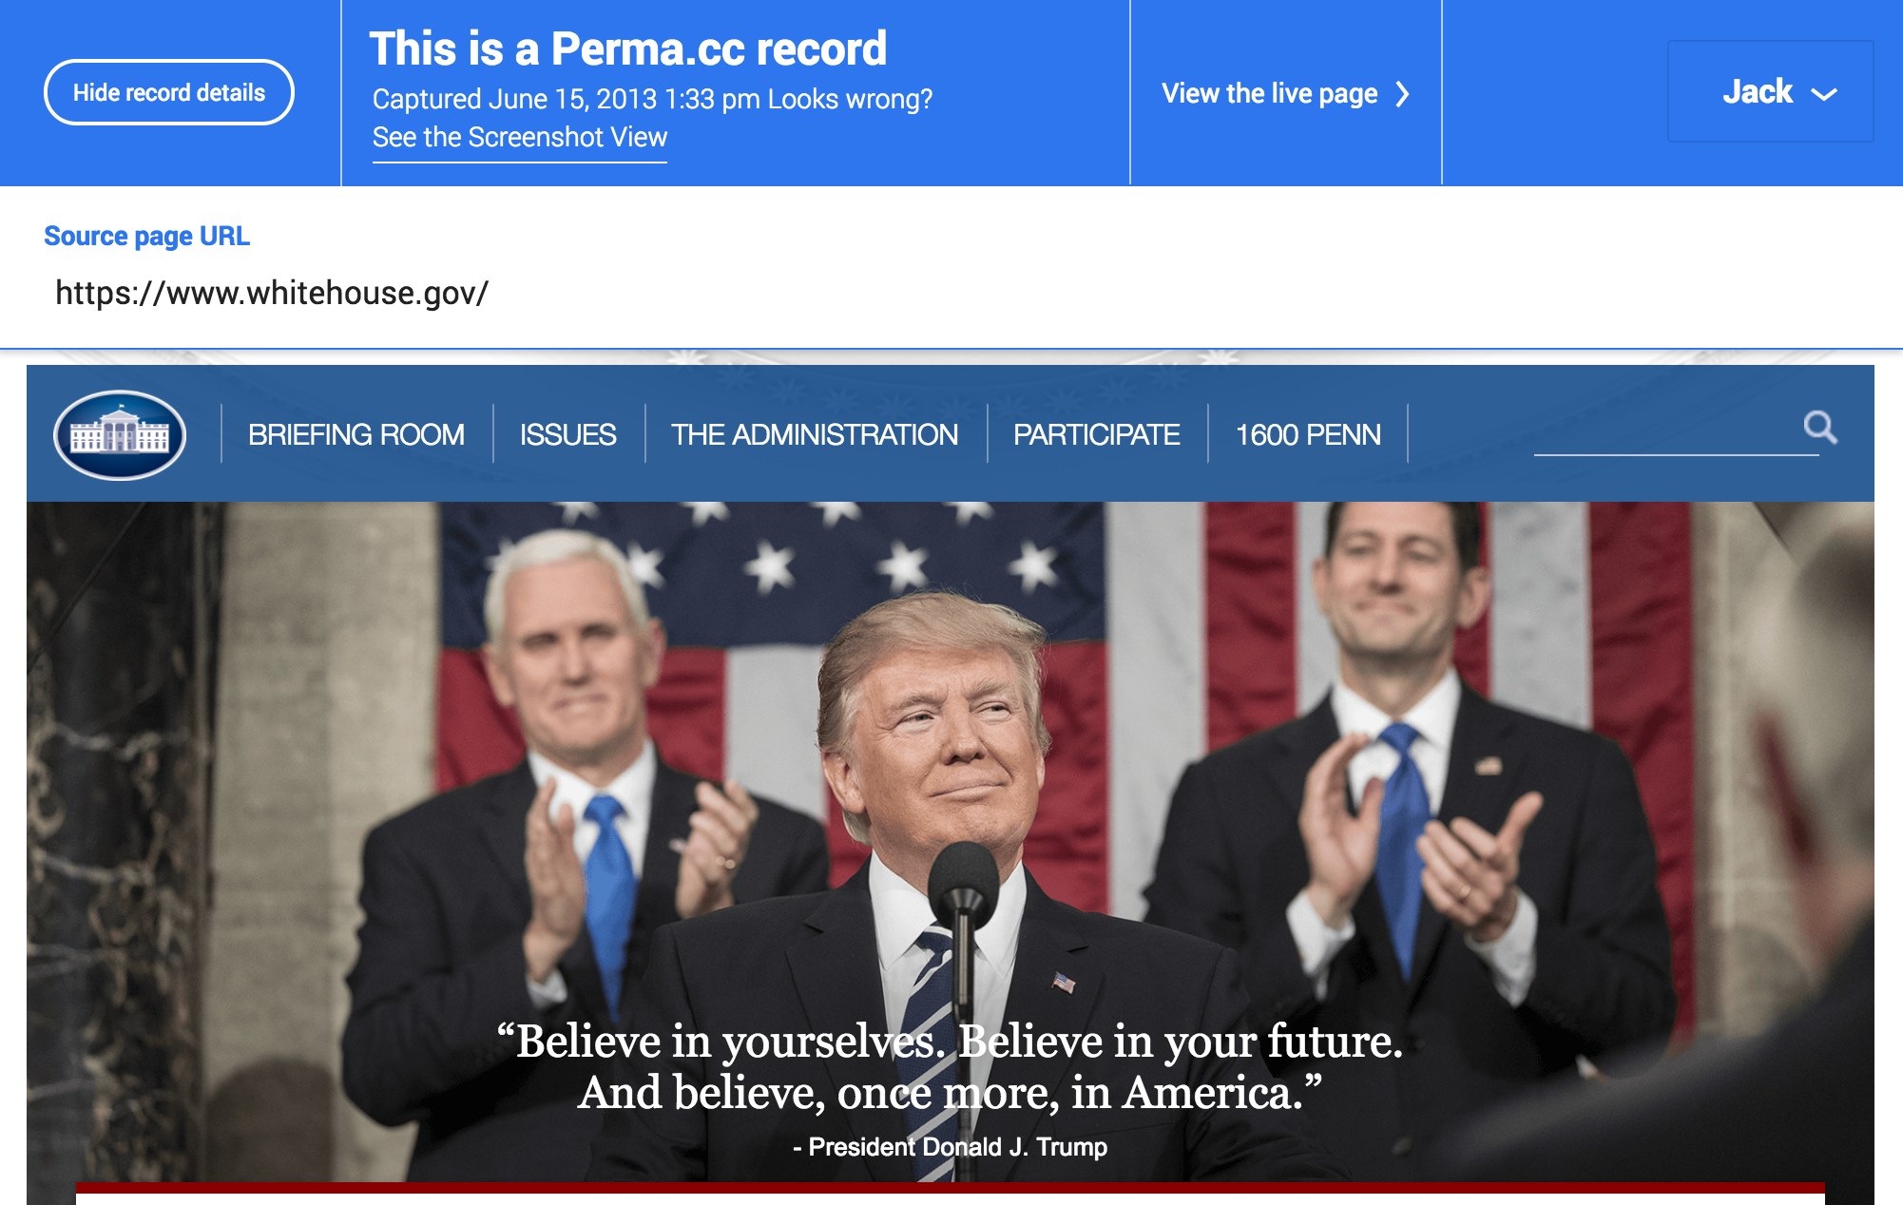
Thinking like a Hacker: Security Considerations for High-Fidelity Web Archives
Banner Spoofing
Mitigation
Do not inject banners into replay frames
Serve the banner from a separate domain
View the archive using a browser proxy
Source: Thinking like a Hacker: Security Considerations for High-Fidelity Web Archives
Evan Savaria, 2020-11-05, Rewriting History, Thinking Like a Hacker
17

Slide 18
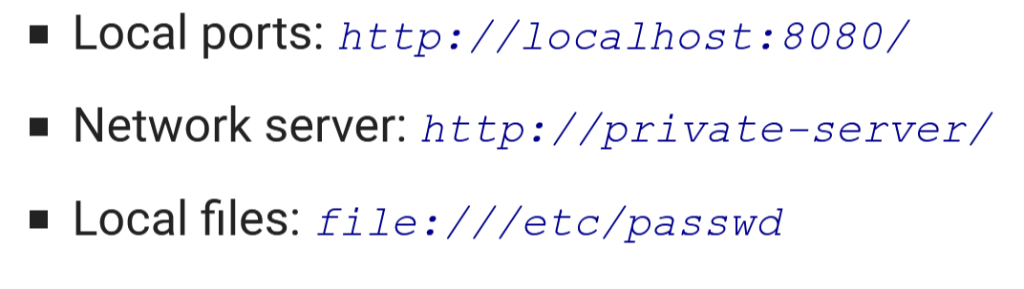
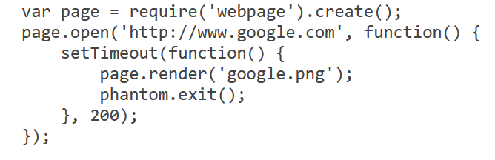
Thinking like a Hacker: Security Considerations for High-Fidelity Web Archives
Threats during Capture
Archiving Local Content
(Threat):
Capture system with privileged access
Resources could be published to a public archive
(Mitigation):
Do not use local networks to capture data
Use only secure (https) connections
Use a Virtual Machine
Headless Browser
(Threat):
Captures use PhantomJS and other browsers on the server
Many browsers are not completely secure
(Mitigation):
Use a virtual machine to capture data
Ensure browsers and software is up to date
Source: Thinking like a Hacker: Security Considerations for High-Fidelity Web Archives
Source: https://phantomjs.org/
Evan Savaria, 2020-11-05, Rewriting History, Thinking Like a Hacker
18

Slide 19
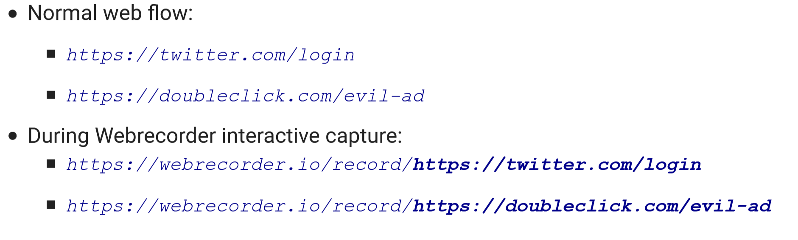
Thinking like a Hacker: Security Considerations for High-Fidelity Web Archives
Stealing Secrets during Capture
Login credentials being recorded
Thinking like a Hacker: Security Considerations for High-Fidelity Web Archives
(Mitigation):
Use a proxy or separate browser
Evan Savaria, 2020-11-05, Rewriting History, Thinking Like a Hacker
19

Slide 20
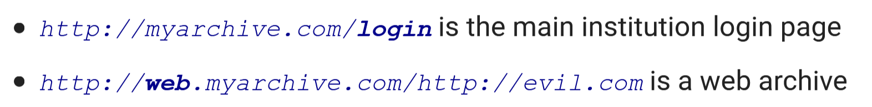
Thinking like a Hacker: Security Considerations for High-Fidelity Web Archives
Cross Site Scripting to Steal Archive Logins
Thinking like a Hacker: Security Considerations for High-Fidelity Web Archives
(Mitigation):
Use iframes to isolate web archive content
Load web archive app from app domain
Evan Savaria, 2020-11-05, Rewriting History, Thinking Like a Hacker
20

Slide 21
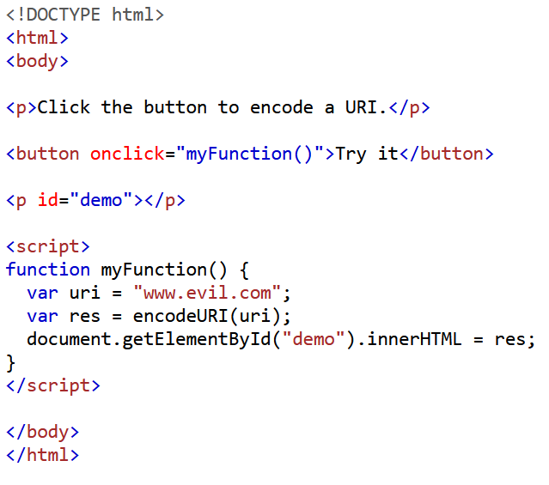
Thinking like a Hacker: Security Considerations for High-Fidelity Web Archives
Live Web Leakage on Playback
https://web.archive.org/web/20201105182218/www.website.com
Client
Evil.com
(Mitigation):
Content-Security-Policy header can limit access to web archive domain
Evan Savaria, 2020-11-05, Rewriting History, Thinking Like a Hacker
21

Slide 22
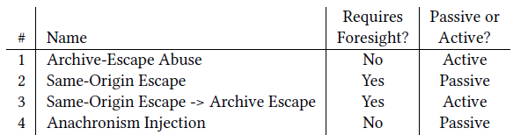
Passive and Active Attacks
Source: Rewriting History: Changing the Archived Web from the Present
Key Points
Some Attacks require foresight
Partial control vs. full control
Live web vs. archived snapshot
Evan Savaria, 2020-11-05, Rewriting History, Thinking Like a Hacker
22

Slide 23
Three-Fourths of Archived Sites are Vulnerable
TrackingExcavator is a Chrome extension used to automatically visit a set of input URLs at specified timestamps located on the Wayback Machine
Collects event traces for all HTTP requests to locate vulnerabilities
http://trackingexcavator.cs.washington.edu/
Datasets for Attacks (1-4) came from three sets of URLs
Top 500: https://www.alexa.com/topsites
Top Million: http://s3.amazonaws.com/alexa-static/top-1m.csv.zip
Legal URLs: https://www.lexisnexis.com/en-us/gateway.page
https://www.westlaw.com/
Evan Savaria, 2020-11-05, Rewriting History, Thinking Like a Hacker
23

Slide 24
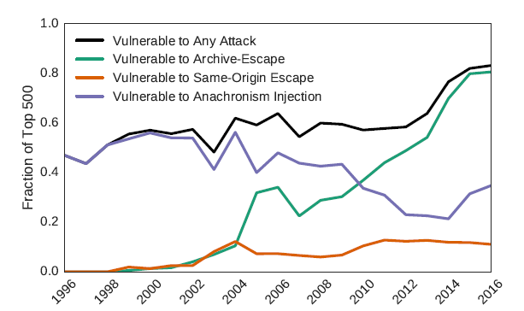
Prevalence of Vulnerabilities on Archived Domains
80% of Top Million are
Vulnerable
73% Vulnerable to (1 of 4) attacks
Source: Rewriting History: Changing the Archived Web from the Present
Evan Savaria, 2020-11-05, Rewriting History, Thinking Like a Hacker
24
Notes:
The vulnerabilities are widespread and vary in type
Chart shows how archives and users should stay vigilant, given the number of occurrences shown

Slide 25
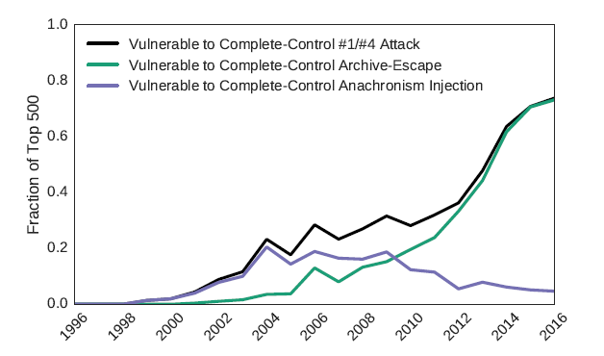
Vulnerability to Strong Attacks
65% of Top Million are
Vulnerable
38% Vulnerable to Attacks
1 & 4
Source: Rewriting History: Changing the Archived Web from the Present
Evan Savaria, 2020-11-05, Rewriting History, Thinking Like a Hacker
25

Slide 26
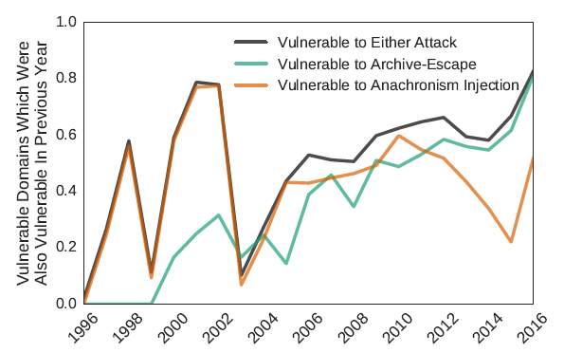
Doman Vulnerability Over Time
80%
Vulnerabilities in 2016 were also vulnerabilities in 2015
Source: Rewriting History: Changing the Archived Web from the Present
Evan Savaria, 2020-11-05, Rewriting History, Thinking Like a Hacker
26
Notes:
Chart represents the number of continuously vulnerable snapshots each year
structured or designed properly to defend against these attacks

Slide 27
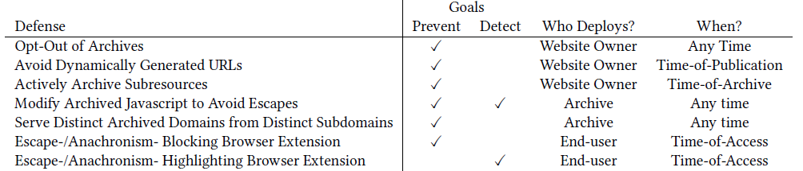
Defense Against Attacks
Overall defense goal is to give users of the archives more confidence in the web’s past
Defense techniques are organized by “who” deploys them and “when” they can be deployed
Many ordinary users will never deploy these defenses
ArchiveWatcher is a Chrome extension used to detect and block archive-escapes and anachronisms
https://github.com/UWCSESecurityLab/archive-watcher
Evan Savaria, 2020-11-05, Rewriting History, Thinking Like a Hacker
27

Slide 28
Defense Methods
Defenses Deployed by Website Publishers
Opt-Out of archives
Avoid dynamically generated URLs to avoid Archive-Escapes
Actively archive sub-resources
Defenses Deployed by Web Archives
Use content security policy headers to block escapes
Modify/Analyze JavaScript to prevent escapes
Serve distinct archived domains from distinct subdomains
Defense Methods Deployed by Clients
Use browser extensions to block escapes and anachronisms
Evan Savaria, 2020-11-05, Rewriting History, Thinking Like a Hacker
28

Slide 29
Contributions
The Wayback Machine was studied to identify vulnerabilities allowing attackers to modify snapshots
Attacks and proof-of-concepts were developed to uncover these vulnerabilities and describe the steps required to be successful
Prevalence and commonality of these attacks were measured and metrics were provided
Explored defense practices that can be deployed by archives, website publishers, and end-users
Developed ArchiveWatcher to detect and defend against these vulnerabilities
Evan Savaria, 2020-11-05, Rewriting History, Thinking Like a Hacker
29

Slide 30
Conclusions/Final Thoughts
There are many attacks that can manipulate how users view archived content on the Wayback Machine
There is always the chance for accidental inaccuracies
Authors of “Rewriting History: Changing the Archived Web from the Present” explored the several vulnerabilities of the Wayback Machine and want their readers to:
Take steps to prevent or detect intentional manipulation
Authors of “Thinking like a Hacker: Security Considerations for High-Fidelity Web Archives” want their readers to:
Build tools for web archive security research
Challenge researchers to find security issues
30
Evan Savaria, 2020-11-05, Rewriting History, Thinking Like a Hacker

